Slide 1

Automated Feedback Analysis Workflow
Joseph Boring
AI Automation | Project 3

Slide 2
Introduction
This project creates a fully automated system for analyzing customer feedback in real-time.
The goal is to capture survey responses, use AI to synthesize the feedback into a single sentiment and a concise summary, and then update a central tracking sheet with these actionable insights.
The system also includes a proactive alert for negative feedback via email to relevant parties, allowing for rapid response.
Tools Used:
Google Forms: To capture customer satisfaction and detailed text feedback.
Make.com: As the automation backbone, orchestrating the entire data flow from capture to analysis and storage.
Google Gemini AI: To perform a synthesized analysis of the user's satisfaction score and written comments, returning a single structured JSON object.
Google Sheets: To serve as the master database, storing original responses and the new AI-generated insights.
Gmail: To send automated email alerts for negative feedback, enabling prompt customer success intervention.

Slide 3
Workflow diagram
The workflow ensures each form submission is cleaned, analyzed, and correctly routed to update the appropriate record.
Google Forms - Watch Responses: The workflow triggers instantly upon a new form submission.
Google Gemini AI - Create a Completion: The satisfaction score and written feedback are sent to Gemini. The prompt instructs the AI to synthesize both inputs into a single sentiment and summary.
Tools - Set variable: This module pre-cleans the AI's response using a replace() formula to strip any potential markdown formatting, ensuring the data is ready for parsing.
JSON - Parse JSON: Takes the clean variable from the previous step and parses the text into a structured JSON object that Make.com can use.
Tools - Sleep: The scenario is intentionally paused for 5 seconds. This is a best practice to prevent "race conditions" and ensures the Google Sheet has time to be fully updated by the form before we try to search it.
Router: The workflow splits here based on the AI's output. It directs the data down one of two paths.
Path 1 (Negative Sentiment): If the sentiment is "Negative," the data proceeds down a path that includes an email alert.
Path 2 (Default): For all other sentiments (Positive, Neutral), the data proceeds down a standard update path.
Google Sheets - Search Rows: (On both paths) This module searches the spreadsheet to find the exact row to update. It uses the content of the "describe your experience" field as a unique identifier to locate the corresponding row.
Google Sheets - Update a Row: (On both paths) Using the Row number found in the search step, this module updates the correct row with the sentiment and summary from the parsed JSON.
Gmail - Send an Email: (On the Negative path only) An email is sent to a specified address containing the full details of the negative feedback for immediate review.

Slide 4
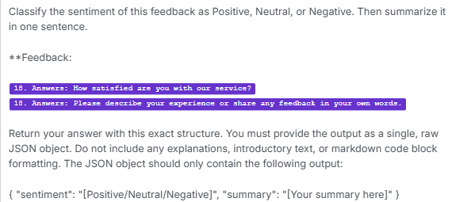
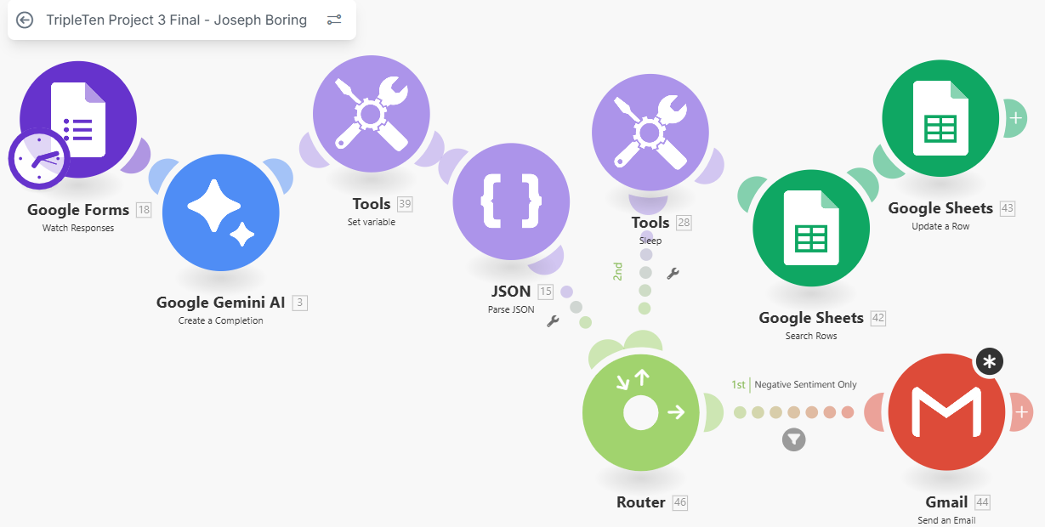
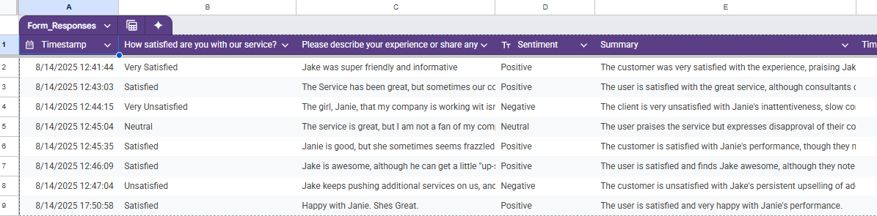
Workflow in action
Gemini Prompt
Json Blueprint Export
Spreadsheet Link

Slide 5
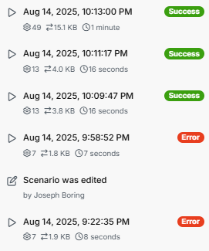
Results
The workflow successfully processed all test submissions, demonstrating its ability to synthesize feedback and provide valuable, structured data.
Sample Positive:
"The customer is satisfied with Janie's performance, though they note she can seem frazzled."
Test Run Log
Sample Negative:
"The client is very unsatisfied with Janie's inattentiveness, slow response times, and frequent meeting cancellations."
Sample Neutral:
"The user praises the service but expresses disapproval of their co-branding partnership."

Slide 6
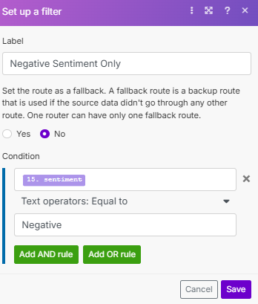
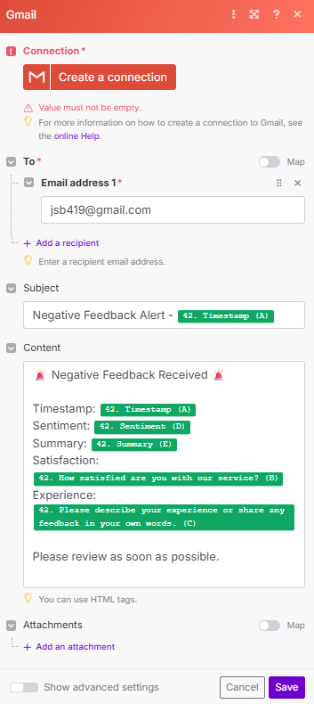
Optional extras
A Router module was added to the workflow to check the sentiment of every piece of feedback.
If the sentiment is "Negative," the Router directs the data to a Gmail module.
This module is configured to send an immediate email alert containing the timestamp, satisfaction level, summary, and full text of the negative feedback. This allows the Customer Success team to proactively address user issues and prevent potential churn.
(Note: While the final Google account connection encountered an OAuth setup issue, the workflow logic is fully implemented and demonstrates a complete, end-to-end solution design.)

Slide 7
Challenges
The project's success required overcoming several technical challenges, resulting in a robust and reliable automation.
What Worked Well (The Challenges & Solutions):
Challenge: Ensuring Data Integrity. The initial workflow could have tried to update the Google Sheet before the new row from the form submission was fully saved.
Solution: A “Tools - Sleep” module was added to pause the scenario for 5 seconds. This deliberate delay ensures the target row exists before the search-and-update process begins, preventing errors.
Challenge: Updating the Correct Row. The system needed a reliable way to find the specific row associated with the form response to avoid creating duplicates or updating the wrong data.
Solution: A “Google Sheets - Search Rows” module was implemented. It cleverly uses the unique text from the "describe your experience" answer as a filter to locate the exact row number. This dynamic Row number is then mapped in the “Google Sheets - Update a Row” module for a precise update every time.
Challenge: Inconsistent AI Output. As anticipated, the Gemini AI module would occasionally return its valid JSON output wrapped in markdown code formatting (```json...```), which would cause the “Parse JSON” module to fail.
Solution: A “Tools - Set Variable” module was placed immediately after the AI. It uses a “replace()” formula to proactively strip any unwanted formatting from the AI's text output, guaranteeing that the “Parse JSON” module always receives a clean, valid string.

Slide 8
Improvements
Potential Improvements:
More Robust Search Filter: While using the feedback text as a filter works, it could fail if two users write the exact same thing. A future improvement would be to use the unique Response ID from the Google Forms trigger or the Timestamp as the search key for a 100% guaranteed match.
Resolve Google OAuth Connection: Complete the Google Cloud Platform setup to resolve the Gmail connection issue and make the negative sentiment alerts fully operational.
Expand Notification Channels: Integrate Slack notifications in addition to email, allowing the team to receive alerts in their primary communication channel.

Slide 9
In Conclusion…
This project successfully transforms a manual feedback collection process into a fully automated, real-time intelligence system. By integrating Google Forms, Gemini AI, and Google Sheets through Make.com, the workflow delivers immediate and actionable insights that were previously time-consuming to obtain.
Key Achievements & Business Value:
Eliminates Manual Work: Frees the Customer Success team from manually reading, interpreting, and logging every piece of feedback, saving significant time.
Provides Instantaneous Insights: Sentiment and summaries are generated and stored within seconds of a user clicking "submit," allowing for an up-to-the-minute understanding of customer satisfaction.
Enables Proactive Customer Service: The automated negative feedback alert is a critical feature, shifting the team from a reactive to a proactive stance and enabling them to address issues before they escalate.
Creates a Structured Data Asset: The system builds a clean, organized dataset in Google Sheets, perfect for long-term analysis and identifying trends in customer feedback over time.
Ultimately, this automation is more than just a workflow; it's a foundational tool for enhancing customer satisfaction and retention. By providing immediate, clear, and actionable insights, it empowers the team to listen to the voice of the customer at scale and act on it decisively.

